Slide 1
Basic Mechanical Engineering

Slide 2
Prime Movers
The human society has been using energy in various forms for carrying out all of its activities.
Man is using energy practically for doing everything like cook, to run household appliances, to do work, to run machines etc.
Most of energy that we have been using now mainly comes from natural sources like petrol, coal, natural gas etc.
Prime mover is a device which converts natural source of energy into mechanical energy or useful work.

Slide 3
Types of Prime Movers
Types of energy sources used by prime movers
Thermal
Non Thermal

Slide 4
Types of Prime Movers
Thermal
Fuels
(Heat Engines)
Nuclear
(Nuclear Power Plant)
Geothermal
(Geothermal Power Plant)
Bio – Energy
(Bio Gas Plant)
Direct Solar Energy

Slide 5
Types of Prime Movers
Non Thermal
Hydel Energy
Tidal Energy
Wind Energy

Slide 6
Types of Prime Movers
Fuels
External Combustion Engine
Internal Combustion Engine

Slide 7
Types of Prime Movers
External Combustion Engine
Steam Engine
(Reciprocating)
Steam Turbine
(Rotary)
Closed Cycle Gas Turbine
(Rotary)

Slide 8
Types of Prime Movers
Internal Combustion Engines
I. C. Engines
(Reciprocating)
Open Cycle Gas Turbine
(Rotary)

Slide 9
Force
Force: It is the product of mass and acceleration of body upon which it is applied.
As per newton’s second law of motion
F α a
F = ma
Where m = mass of body in kg
SI unit of mass is kg and acceleration is m/s² so, SI unit of force is Newton (N).

Slide 10
Weight and Mass
Weight: It is force exerted by gravity
Weight = Mass x Gravitational acceleration
W = m x g
Mass: Mass is the quantity of matter and it is constant.

Slide 11
Pressure
Pressure: It is the force per unit area.
P = F / A
SI unit of pressure is N / m² or Pascal (Pa).
Pressure is measured by pressure gauge is called Gauge Pressure.
Pressure gauge, Manometers etc are used to measure gauge pressure.
Barometer is used to measure atmospheric pressure.
Standard atmospheric pressure is 1.01325 bar.
1 bar = 10⁵ Pa

Slide 12
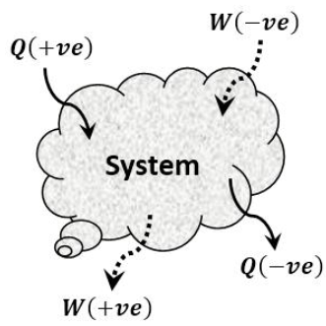
Work
Work: work done is the product of force and the distance it moves in the direction of force.
W = Force x Distance
If work is done by the system then it is positive work.
If work is done on the system then it is negative.
SI unit of work done is Nm or Joule (J).

Slide 13
Power
Power: It is defined as the rate of doing work or work done per unit time.
P = Work done / Time
SI unit of power is Joule / Second or Watt (W)

Slide 14
Energy
Energy:
Energy, a word derived from the Greek word “Energeia”, means capacity for doing work.
The different forms of energies are Mechanical energy, Electrical Energy, Chemical Energy, Thermal or Heat Energy, Nuclear Energy.
The Law of conservation of Energy :
Energy can neither be created nor be destroyed, it can change from one form to another form.

Slide 15
Energy
High Grade Energy:
Energy that can completely converted (Neglecting Loss) into work. Ex.: Mechanical work, Electrical energy, wind and tidal energy.
Low Grade Energy:
Only a certain portion of energy that can be converted into mechanical work. Ex.: Heat derived from combustion of fuels

Slide 16
Types of Mechanical Energy
Potential Energy:
The energy which a body possesses by virtue of its elevation or position. Ex.: Water stored at high level of dam.
P.E. = m x g x h
Where m = mass of body in kg, h = height, g = Gravity = 9.81 m/s²
Kinetic Energy:
The energy which a body possesses by virtue of motion. Ex.: Jet of water coming out of nozzle.
K.E. = ½ mV² m = mass of body, V = velocity of body

Slide 17
Heat
Heat: It may be defined as the energy interaction at the system boundary which occurs due to temperature difference only.
If heat transfer to the system then it is positive heat.
If heat transferred from the system then it is negative heat.
SI unit of heat is Joule (J)

Slide 18
Temperature
Temperature: Qualitative indication of hotness or coldness can be exactly defined by using thermodynamic property known as temperature.
SI unit of temperature is Kelvin (K) or degree Celsius (⁰C)

Slide 19
Specific Heat Capacity
It may be defined as the quantity of heat required to raise the temperature of unit mass of substance by one degree.
C_{p} = Q / ( m x ∆ T )
SI unit of specific heat is J / Kg K

Slide 20
Change of State
The various states of substance are solid, liquid and gas
Melting Point:
It is the temperature at which solid is converted into liquid when heat is supplied.
Boiling Point:
It is the temperature at which liquid is converted vapour or gas when heat is supplied.

Slide 21
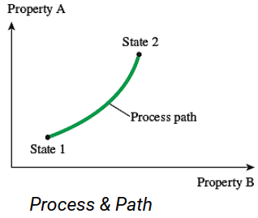
Process, path and cycle
Process: Any change that system undergoes from one equilibrium state to another is known as process.
Path: Path is the series of states through which a system passes during a process.

Slide 22
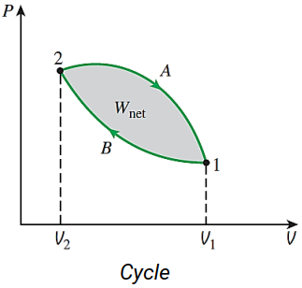
Process, path and cycle
Cycle: A system is said to have undergone a cycle if it returns to its initial state at the end of process.
For cycle, Initial and final states are identical.

Slide 23
Internal Energy and Enthalpy
Q = W +U
H = U + pV

Slide 24
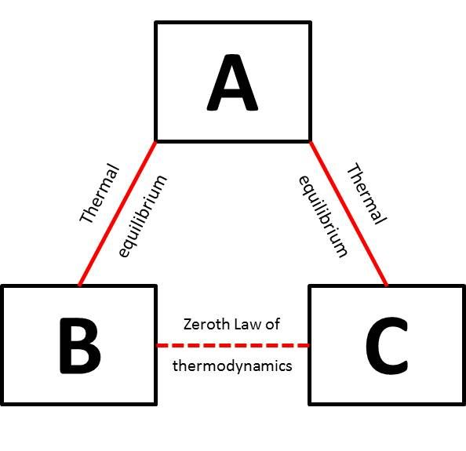
Laws of Thermodynamics
Zeroth Law of Thermodynamics: It states that if the bodies A and B are in thermal equilibrium with third body C separately then the two bodies A and B are in thermal equilibrium with each other.
It is the principle of temperature measurement.

Slide 25
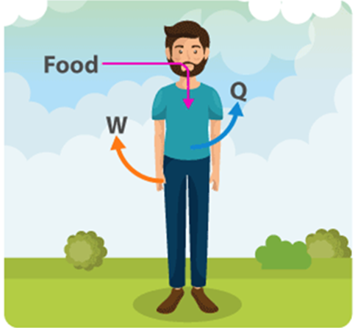
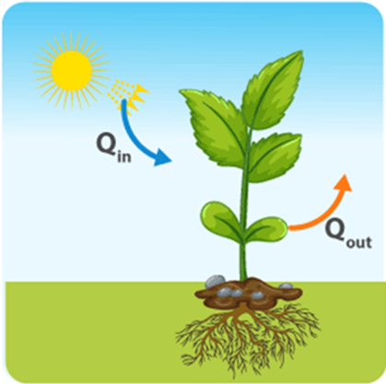


Laws of Thermodynamics
First Law of Thermodynamics: It states that energy can neither be created nor be destroyed, it can be converted from one form to another form.

Slide 26
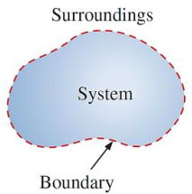
Thermodynamic Systems
It is defined as quantity of matter or region in space under consideration for analysis.
Everything outside the system boundary is called surrounding.
Universe = System + Surroundings

Slide 27
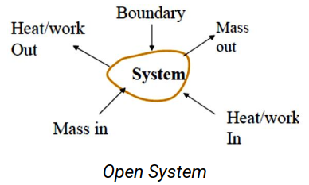
Thermodynamic Systems
Open System: In which energy and mass both can transfer from system to surrounding or vise versa.

Slide 28
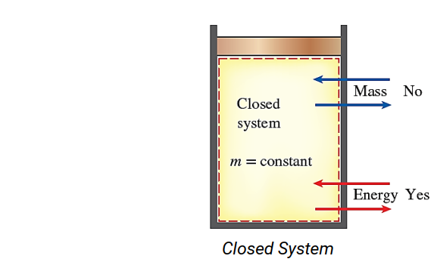
Thermodynamic Systems
Closed System: In which only energy can transfer from system to surrounding or vise versa, no mass transfer across its boundary.

Slide 29
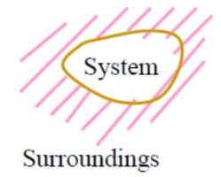
Thermodynamic Systems
Isolated System: In which neither energy nor mass can transfer from system to surrounding or vise versa.
Examples: The universe and perfectly insulated closed vessel (Thermos flask).

